Slide 1
Sentiment Analysis of Public’s Opinion on Amber Alert using Twitter
Chun Yin Yan
Hongshuo Zhou

Slide 2
Problem Description
An Amber Alert is a message which informs the public that a child has been abducted. When an Amber Alert is received on a mobile device, a loud sound is played and the device vibrates. Some devices do not have the ability to turn off Amber Alerts.
Controversies:
Disrupt People’s daily activity (e.g. sleeping, driving)
We experienced this once at 4am!
Alert messages are vague or delayed
We didn’t find any related research on this topic.

Slide 3
Motivation
We want to identify tweets which are informational and tweets which are opinion-based regarding Amber alert.

Slide 4
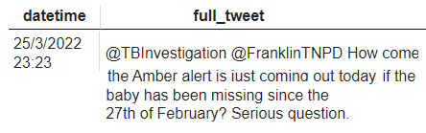
The dataset
Extract 2837 tweets mentioning “Amber Alert” from Twitter
The raw dataset includes date and time, the full tweet
Tweets collected are from 2022-03-25 to 2022-04-01
Retweets (reposting other people’s Tweet) are filtered and removed.
An example of a raw sample data:

Slide 5
Labelling the data
We manually labelled the sentiment of 1223 tweets.
0 means a negative opinion on the Amber Alert/Amber Alert System
Example: @TBInvestigation @FranklinTNPD How come the Amber alert is just coming out today if the baby has been missing since the 27th of February? Serious question.
1 means a neutral opinion or an purely informative tweet on the Amber Alert
Example: 2 teen girls arrested in connection with Milwaukee Amber Alert https://t.co/kovgksdlud
2 means a positive opinion on the Amber Alert/Amber Alert System
Example: Amber Alert ftw. Good news story that.

Slide 6
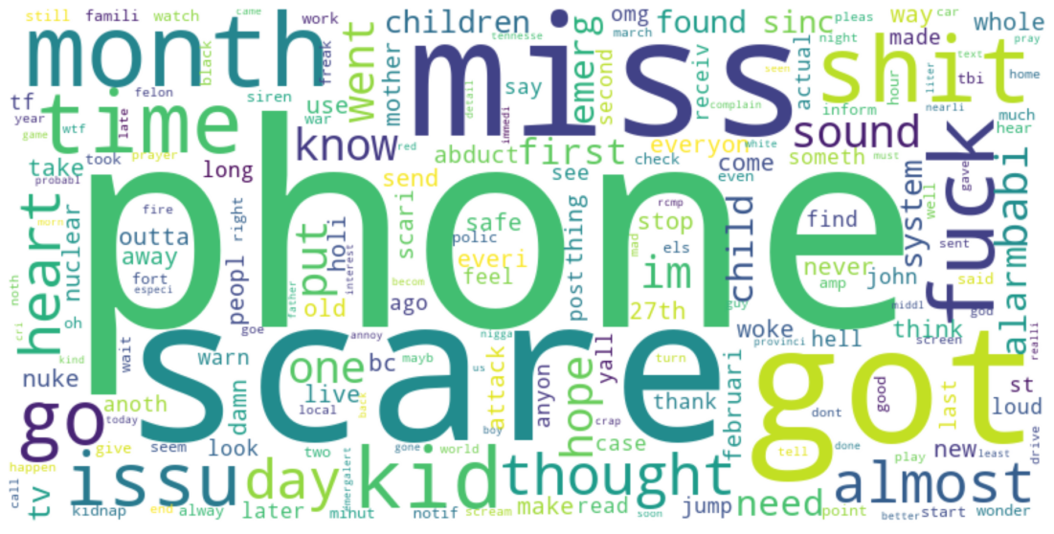
Common tokens in negative tweets

Slide 7
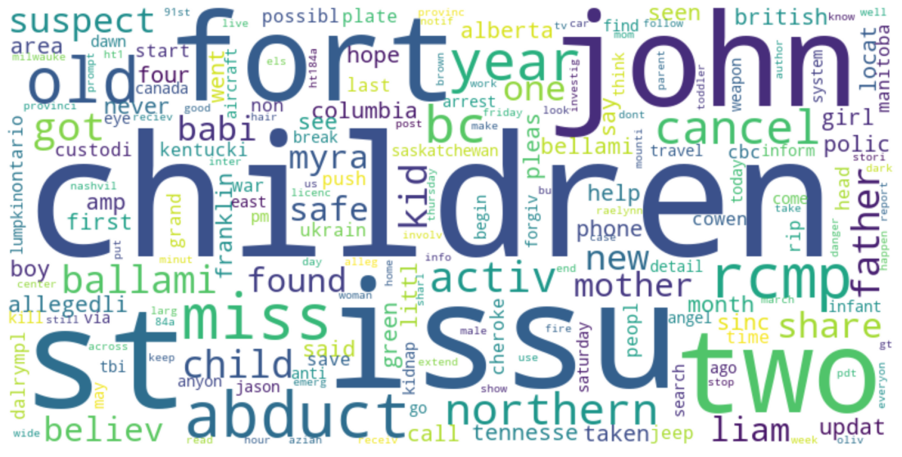
Common tokens in neutral tweets

Slide 8
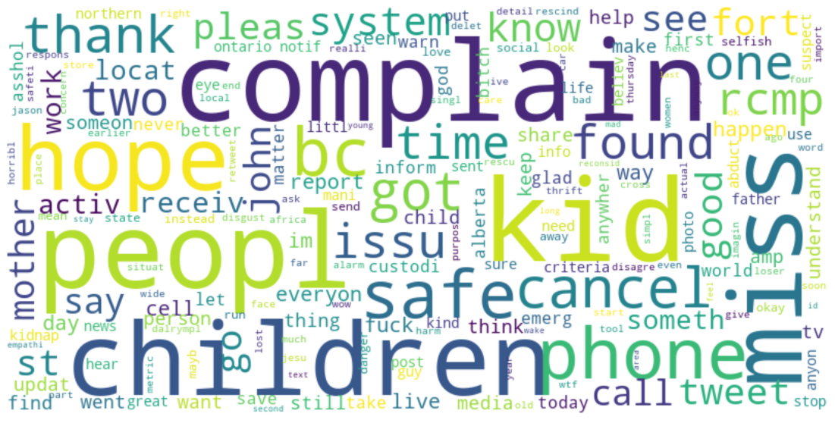
Common tokens in positive tweets

Slide 9
Interesting findings of the Tweets
There are several interesting findings when we analysed the tweets:
Amber Alert has two meanings:
A message which informs the general public that a child has been abducted
A weather alert indicating severe weather conditions (US)
However, based on our inspection, only two tweets in the labelled data are talking about the weather alert.

Slide 10
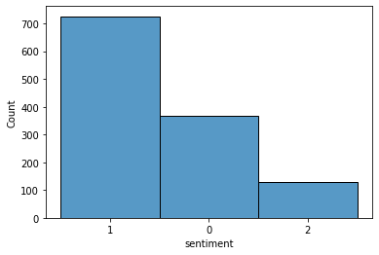
Interesting findings of the Tweets
There are several interesting findings when we analysed the tweets:
2. Nearly half of the tweets are neutral or purely informational, and most of the other tweets contain negative opinion about Amber Alert.
It is a reasonable distribution because the authority usually uses Twitter (and other platforms) to spread information. People are more likely to complain the inconvenience brought by these Amber Alert than praising that the system works because everyone receives a message when Amber Alert is created but NOT when the alert is cancelled.
Neutral Negative Positive

Slide 11
Interesting findings of the Tweets
There are several interesting findings when we analysed the tweets:
3. Tweets which are in favour of Amber Alerts often do not use positive words to express their opinion, but instead use sarcasm to mock people who are against Amber Alerts. For example:
Let me guess, people are complaining about receiving the amber alert. What a world we live in. Someone's kids are missing and need help and people don't want to hear an alarm go off on their phones

Slide 12
Processing the tweets
We took the following steps to process the data so that we can train our machine learning models on them:
Removes replies (@user), URLs (https://…), hashtags (#AmberAlert)
Remove non-alphanumeric unicode characters and punctuations
Turn all alphabets to lowercase
Tokenization
Remove stopwords from the tokens
Stemming

Slide 13
Machine Learning Models
Multiclass supervised learning
Baselines:
Naive Bayes Classifier (Generative, Probabilistic)
Non-baselines:
Multiclass Logistic Regression (Discriminative, Probabilistic)
Linear Discriminant Analysis (Generative, Probabilistic)
Support Vector Machine (Discriminative, Non-probabilistic)

Slide 14
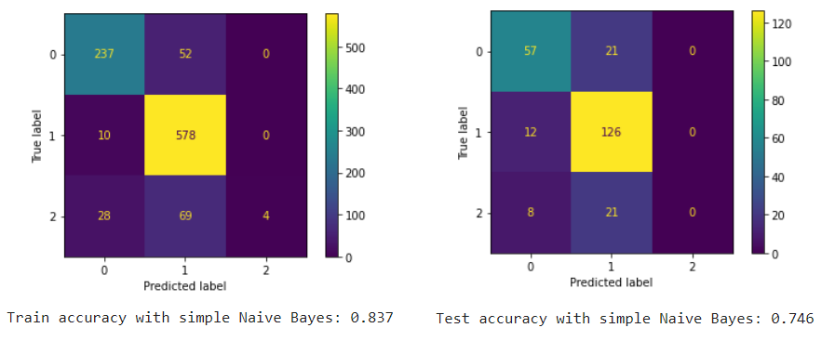
Results: Naive Bayes Classifier

Slide 15
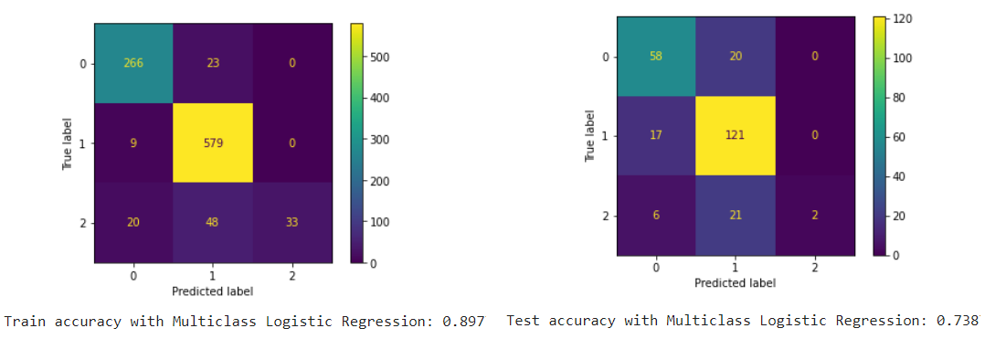
Results: Multiclass Logistic Regression

Slide 16
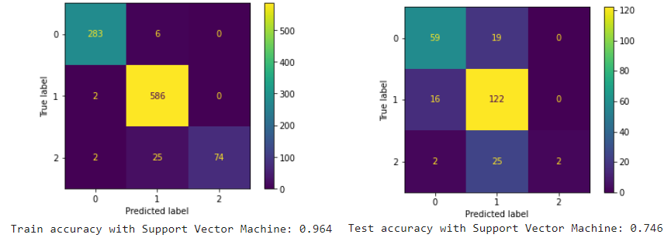
Results: Support Vector Machine

Slide 17
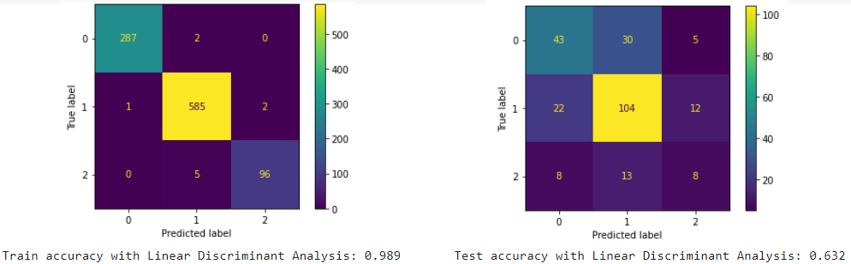
Results: Linear Discriminant Analysis

Slide 18
Results
Machine Learning Model | Training Accuracy | Testing Accuracy
Naive Bayes | 0.837 | 0.746
Multiclass Logistic Regression | 0.897 | 0.738
Support Vector Machine | 0.964 | 0.746
Linear Discriminant Analysis | 0.989 | 0.632

Slide 19
Limitations and Further Research
Limitations
Location keywords (e.g. “Tennessee”) taken account in ML models
Limited data with similar wordings (Only a few Amber Alerts each week)
Tweets are mostly informational
Further Research
Analyse data over a long period
Remove certain tokens (e.g. locations)
Try to solve the overfitting in LDA and SVM
Gain more data and balance the distribution of the labels.

Slide 20
Conclusions
Naive Bayes Classifier and Multiclass Logistic Regression offers very fine predictive power for identifying the sentiment of Tweets about Amber Alerts.
Our recommendations: Take into consideration of time and location to send amber alerts.

Slide 21
Thank you

